Slide 1
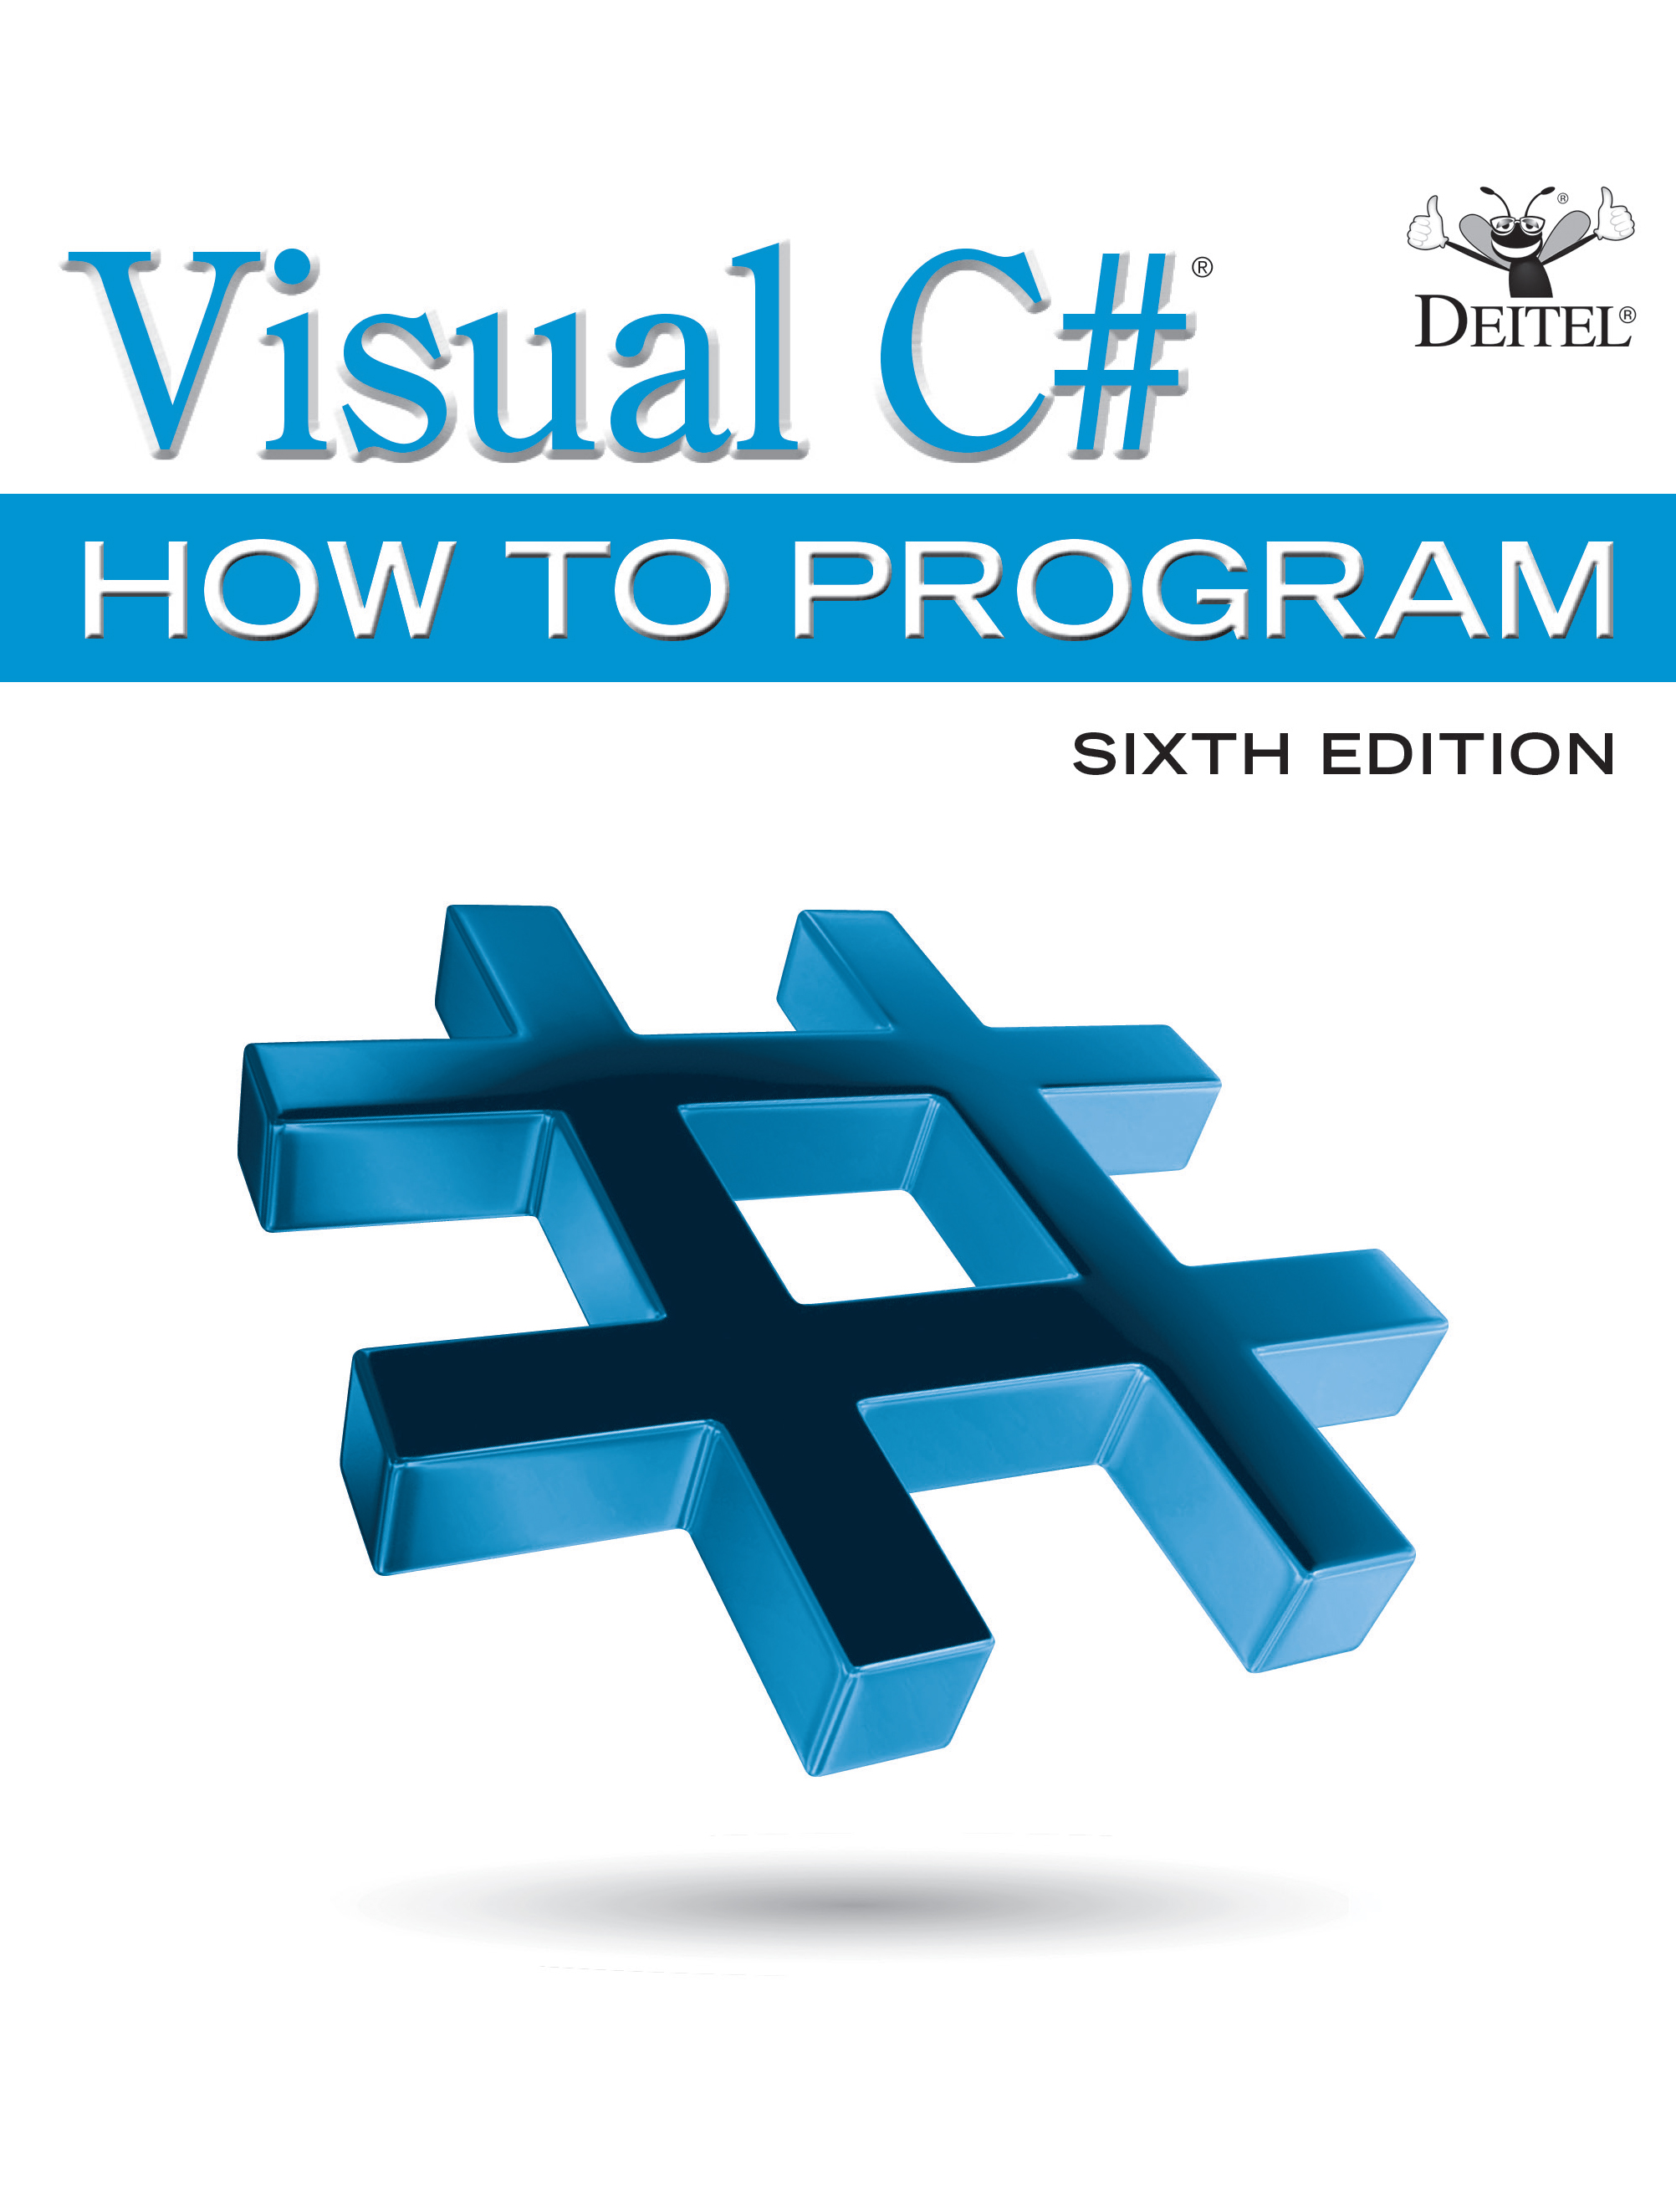
Visual C sharp® How to Program
Sixth Edition
Chapter 8
Arrays; Introduction to Exception Handling
Copyright © 2017 Pearson Education, Inc. All Rights Reserved
Notes:
If this PowerPoint presentation contains mathematical equations, you may need to check that your computer has the following installed:
1) MathType Plugin
2) Math Player (free versions available)
3) NVDA Reader (free versions available)

Slide 2
Learning Objectives (1 of 2)
Use arrays to store data in and retrieve data from lists and tables of values.
Declare arrays, initialize arrays and refer to individual elements of arrays.
Iterate through arrays with the foreach statement.
Use var to declare implicitly typed local variables and let the compiler infer their types from their initializer values.
Use exception handling to process runtime problems.
Declare
getter-only auto implemented properties.

Slide 3
Learning Objectives (2 of 2)
Initialize auto-implemented properties with
auto
property initializers.
Pass arrays to methods.
Declare and manipulate multidimensional arrays—both rectangular and jagged.
Write methods that use variable-length argument lists.
Read command-line arguments into an app.

Slide 4
Outline (1 of 3)
8.1 Introduction
8.2 Arrays
8.3 Declaring and Creating Arrays
8.4 Examples Using Arrays
8.4.1 Creating and Initializing an Array
8.4.2 Using an Array Initializer
8.4.3 Calculating a Value to Store in Each Array Element
8.4.4 Summing the Elements of an Array
8.4.5 Iterating Through Arrays with foreach
8.4.6 Using Bar Charts to Display Array Data Graphically; Introducing Type Inference with var
8.4.7 Using the Elements of an Array as Counters

Slide 5
Outline (2 of 3)
8.5 Using Arrays to Analyze Survey Results; Intro to Exception Handling
8.5.1 Summarizing the Results
8.5.2 Exception Handling: Processing the Incorrect Response
8.5.3 The try Statement
8.5.4 Executing the catch Block
8.5.5 Message Property of the Exception Parameter
8.6 Case Study: Card Shuffling and Dealing Simulation
8.6.1 Class Card and Getter-Only Auto-Implemented Properties
8.6.2 Class DeckOfCards
8.6.3 Shuffling and Dealing Cards

Slide 6
Outline (3 of 3)
8.7 Passing Arrays and Array Elements to Methods
8.8 Case Study: GradeBook Using an Array to Store Grades
8.9 Multidimensional Arrays
8.9.1 Rectangular Arrays
8.9.2 Jagged Arrays
8.9.3 Two-Dimensional Array Example: Displaying Element Values
8.10 Case Study: GradeBook Using a Rectangular Array
8.11 Variable-Length Argument Lists
8.12 Using Command-Line Arguments
8.13 (Optional) Passing Arrays by Value and by Reference
8.14 Wrap-Up

Slide 7
8.1 Introduction
Data structures are collections of related data items.
Arrays are data structures consisting of related data items of the same type.
Arrays are fixed-length entities—they remain the same length once they’re created.

Slide 8
8.2 Arrays (1 of 3)
An array is a group of variables—called elements—containing values that all have the same type.
Arrays are reference types—what we typically think of as an array is actually a reference to an array object.
The elements of an array can be either value types or reference types.

Slide 9
8.2 Arrays (2 of 3)
To refer to a particular element in an array, we spec­ify the name of the reference to the array the element’s position in the array, which is called the element’s index.
Figure 8.1 shows a logical representation of an integer array called c containing sample values.

Slide 10
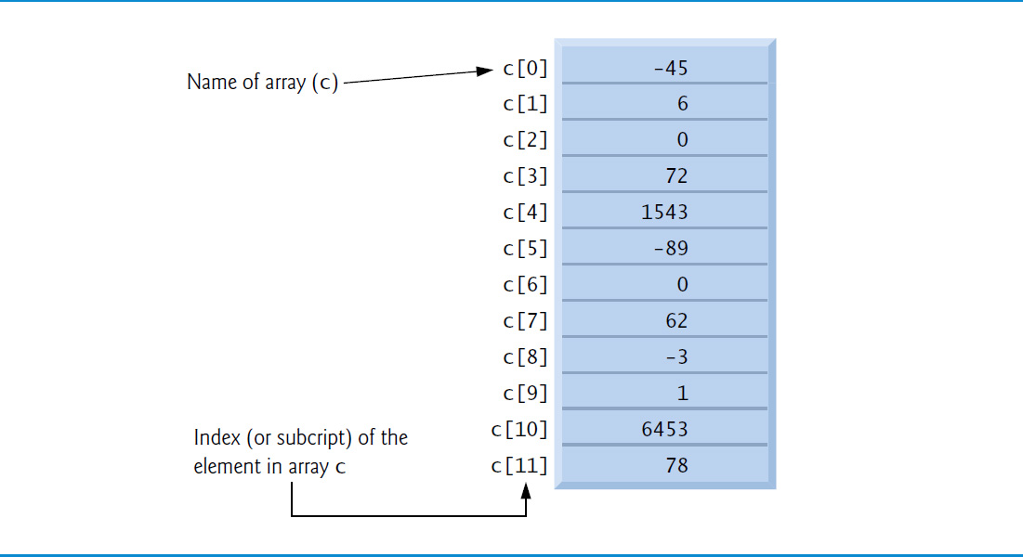
Figure 8.1 A 12-Element Array

Slide 11
8.2 Arrays (3 of 3)
Elements are accessed with an array-access expression that includes the name of the array, followed by the index of the particular element in square brackets ([]).
The first element in every array has index zero and is sometimes called the zeroth element.
An index must be a nonnegative integer and can be an expression.
Every array’s length is stored in its Length property.

Slide 12
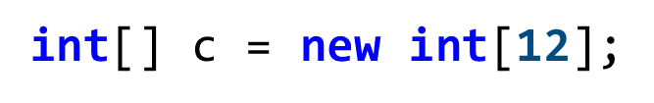
8.3 Declaring and Creating Arrays (1 of 4)
Since arrays are objects, they’re typically created with keyword new.
To create an array object, specify the type and the number of array elements as part of an array-creation expression that uses keyword new.
The following declaration and array-creation expression create an array object containing 12 int elements and store the array’s reference in variable c:

Slide 13
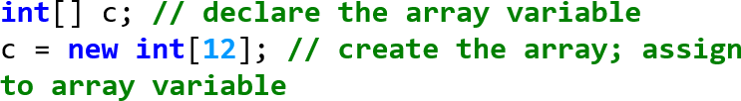
8.3 Declaring and Creating Arrays (2 of 4)
Creating the array also can be performed as follows:
The square brackets following int indicate that c will refer to an array of ints.
The array variable c receives the reference to a new array object of 12 int elements.

Slide 14
8.3 Declaring and Creating Arrays (3 of 4)
The number of elements can also be specified as an expression that's calculated at execution time.
When an array is created, each element of the array receives a default value:
θ for the numeric simple-type elements.
false for bool elements.
null for references.

Slide 15
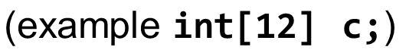
Common Programming Error 8.1
In an array variable declaration, specifying the number of elements in the square brackets
is a syntax error.

Slide 16
8.3 Declaring and Creating Arrays (4 of 4)
Resizing an Array
Though arrays are fixed-length entities, you can use the static Array method Resize which takes two arguments—the array to be resized and the new length—to create a new array with the specified length.
Copies the contents of the old array into the new array
Sets the array variable to reference the new array.
Any content that cannot fit into the new array is truncated without warning.

Slide 17
8.4 Examples Using Arrays (1 of 9)
8.4.1 Creating and Initializing an Array
The app in Figure 8.2 uses keyword new to create an array of five int elements.

Slide 18
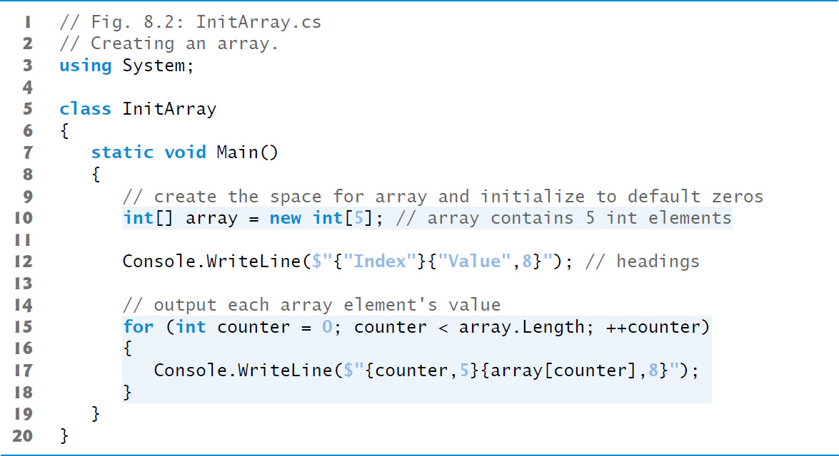
Figure 8.2 Creating an Array (1 of 2)

Slide 19
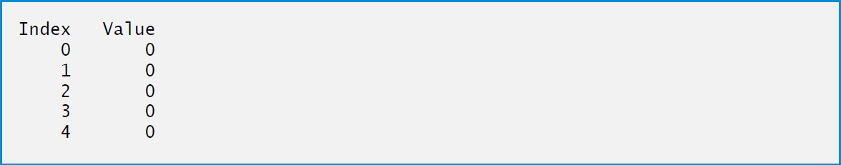
Figure 8.2 Creating an Array (2 of 2)

Slide 20
8.4 Examples Using Arrays (2 of 9)
8.4.2 Using an Array Initializer
An app can create an array and initialize its elements with an array initializer, a comma-separated list of expressions (called an initializer list) enclosed in braces.
The array length is determined by the number of elements in the initializer list.
The app in Figure 8.3 initializes an integer array with 5 values (line 10) and displays the array in tabular format.

Slide 21
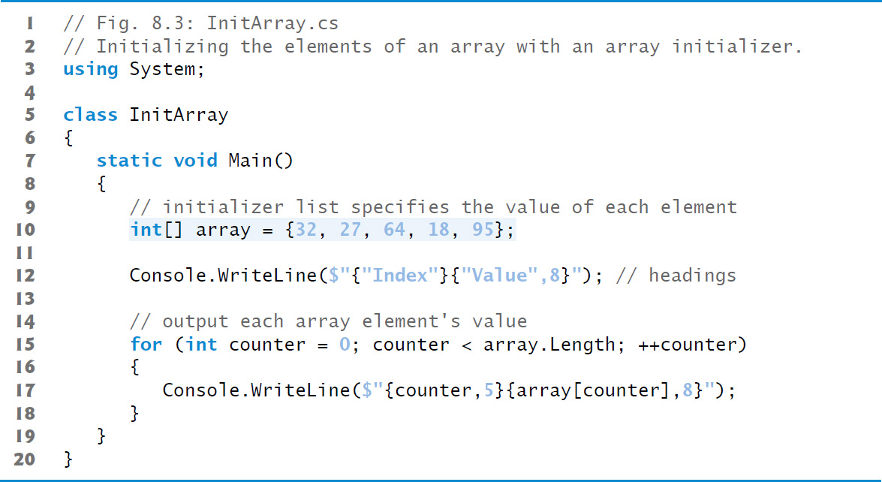
Figure 8.3 Initializing the Elements of an Array with an Array Initializer (1 of 2)

Slide 22
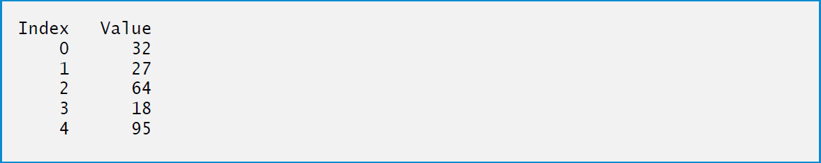
Figure 8.3 Initializing the Elements of an Array with an Array Initializer (2 of 2)

Slide 23
8.4 Examples Using Arrays (3 of 9)
8.4.3 Calculating a Value to Store in Each Array Element
The app in Figure 8.4 creates a 5-element array and assigns to each element one of the even integers from 2 to 10 (2, 4, 6, 8, 10).
Constants must be initialized when they’re declared and cannot be modified thereafter.
Constants use the same Pascal Case naming conventions as classes, methods and properties.

Slide 24
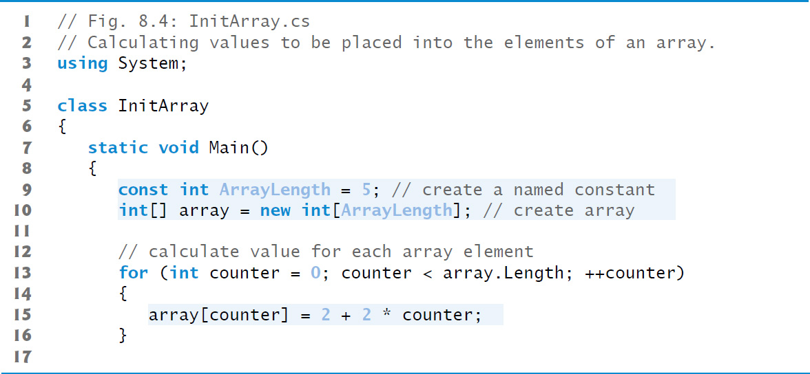
Figure 8.4 Calculating Values to Be Placed into the Elements of an Array (1 of 2)

Slide 25
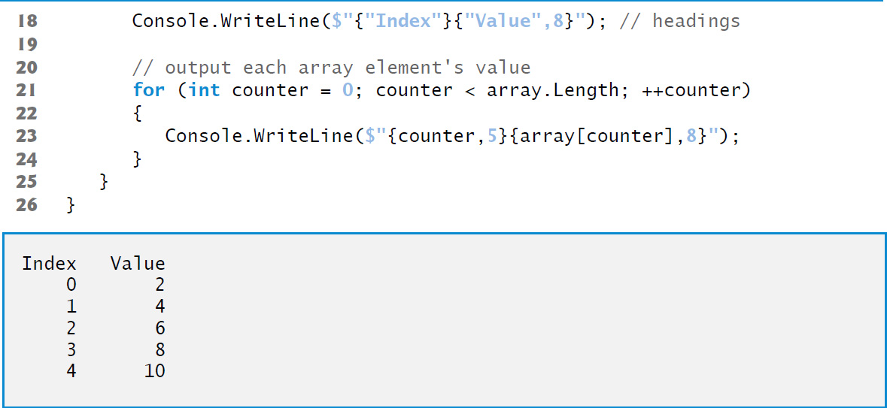
Figure 8.4 Calculating Values to Be Placed into the Elements of an Array (2 of 2)

Slide 26
Good Programming Practice 8.1
Constants are also called named constants. Apps using constants often are more readable than those that use literal values (example 5)—a named constant such as ArrayLength clearly indicates its purpose, whereas the literal value 5 could have different meanings based on the context in which it’s used. Another advantage to using named constants is that if the constant’s value must be changed, the change is necessary only in the declaration, thus reducing code-maintenance costs.

Slide 27
Good Programming Practice 8.2
Defining the size of an array as a named constant instead of a literal makes code clearer. This technique eliminates so-called magic numbers. For example, repeatedly mentioning the size 5 in array-processing code for a five-element array gives the number 5 an artificial significance and can be confusing when the program includes other 5s that have nothing to do with the array size.

Slide 28
Common Programming Error 8.2
Assigning a value to a named constant after it’s been initialized is a compilation error.

Slide 29
Common Programming Error 8.3
Attempting to declare a named constant without initializing it is a compilation error.

Slide 30
8.4 Examples Using Arrays (4 of 9)
8.4.4 Summing the Elements of an Array
The app in Figure 8.5 sums the values contained in a 10-element integer array.

Slide 31
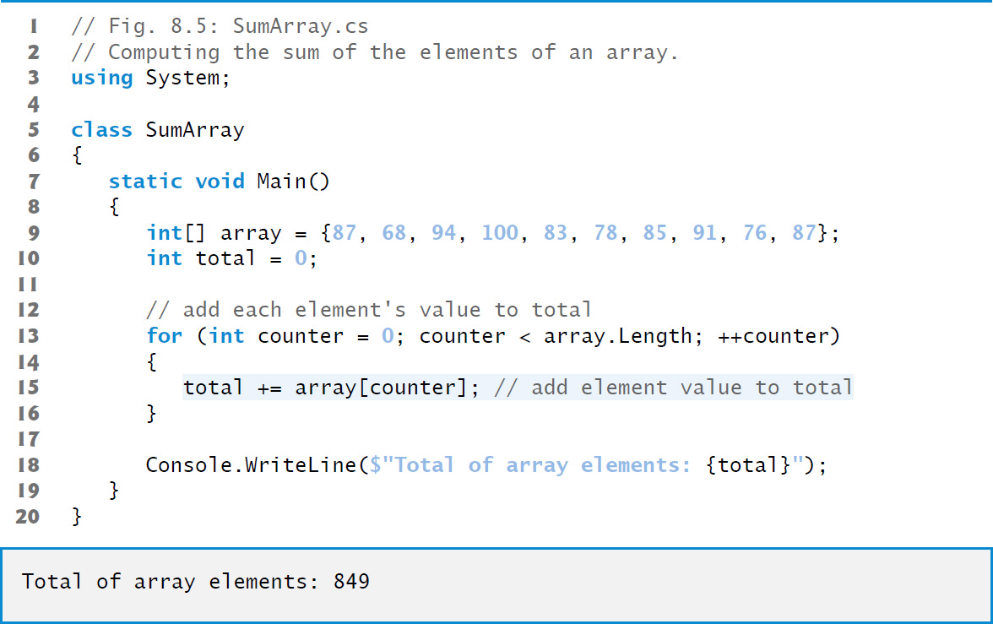
Figure 8.5 Computing the Sum of the Elements of an Array

Slide 32
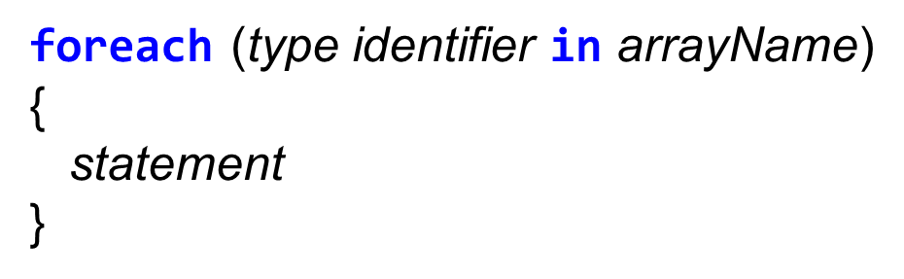
8.4 Examples Using Arrays (5 of 9)
8.4.5 Iterating Through Arrays with foreach
The foreach statement iterates through the elements of an entire array or collection.
The syntax of a foreach statement is:
type and identifier are the type and name (example int number) of the iteration variable.
arrayName is the array through which to iterate.

Slide 33
8.4 Examples Using Arrays (6 of 9)
8.4.5 Iterating Through Arrays with foreach
The type of the iteration variable must be consistent with the type of the elements in the array.
The iteration variable represents successive values in the array on successive iterations of the foreach statement.

Slide 34
8.4 Examples Using Arrays (7 of 9)
Figure 8.6 uses the foreach statement to calculate the sum of the integers in an array of student grades.
The foreach statement can be used in place of the for statement whenever code looping through an array does not need to know the index of the current array element.

Slide 35
Common Programming Error 8.4
Any attempt to change the iteration variable’s value in the body of a foreach statement results in a compilation error.

Slide 36
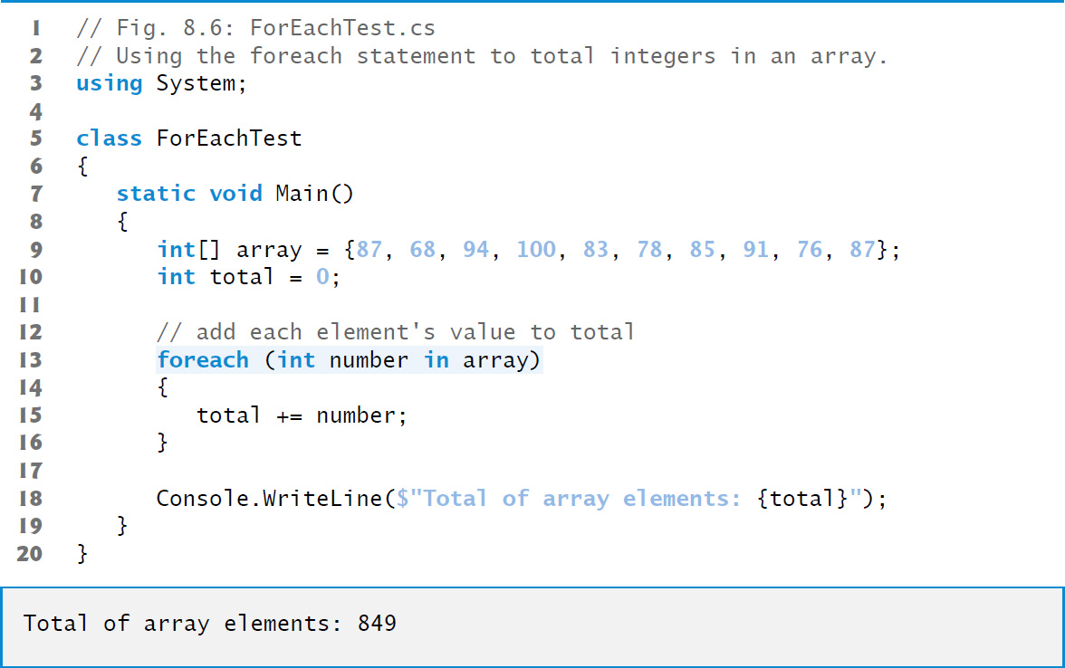
Figure 8.6 Using the foreach Statement to Total Integers in an Array

Slide 37
Common Programming Error 8.5
Attempting to modify an array element’s value using a foreach statement’s iteration variable is a logic error—the iteration variable can be used only to access each array element’s value, not modify it.

Slide 38
8.4 Examples Using Arrays (8 of 9)
8.4.6 Using Bar Charts to Display Array Data Graphically; Introducing Type Inference with var
The app in Figure 8.7 stores grade distribution data in an array of 11 elements, each corresponding to a category of grades.
array[0] indicates the number of grades in the range 0–9.
array[7] indicates the number of grades in the range 70–79.
array[10] indicates the number of 100 grades.

Slide 39
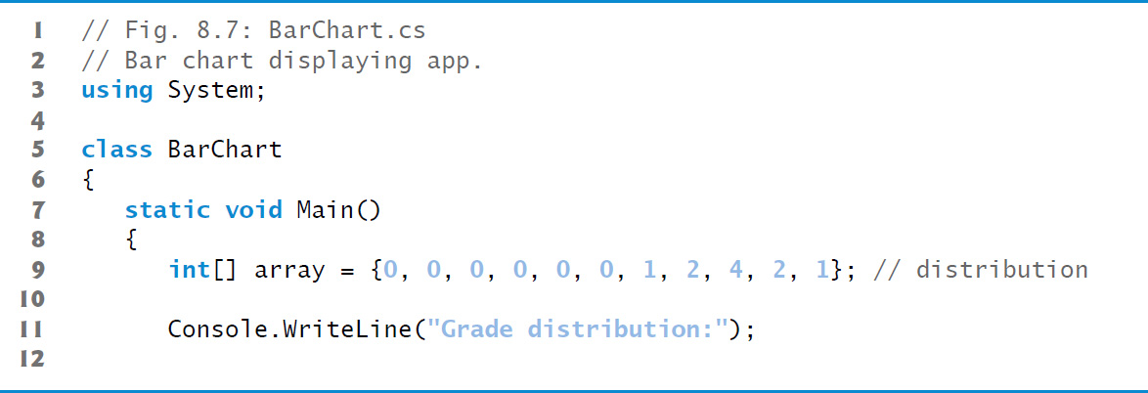
Figure 8.7 Bar Chart Displaying App (1 of 3)

Slide 40
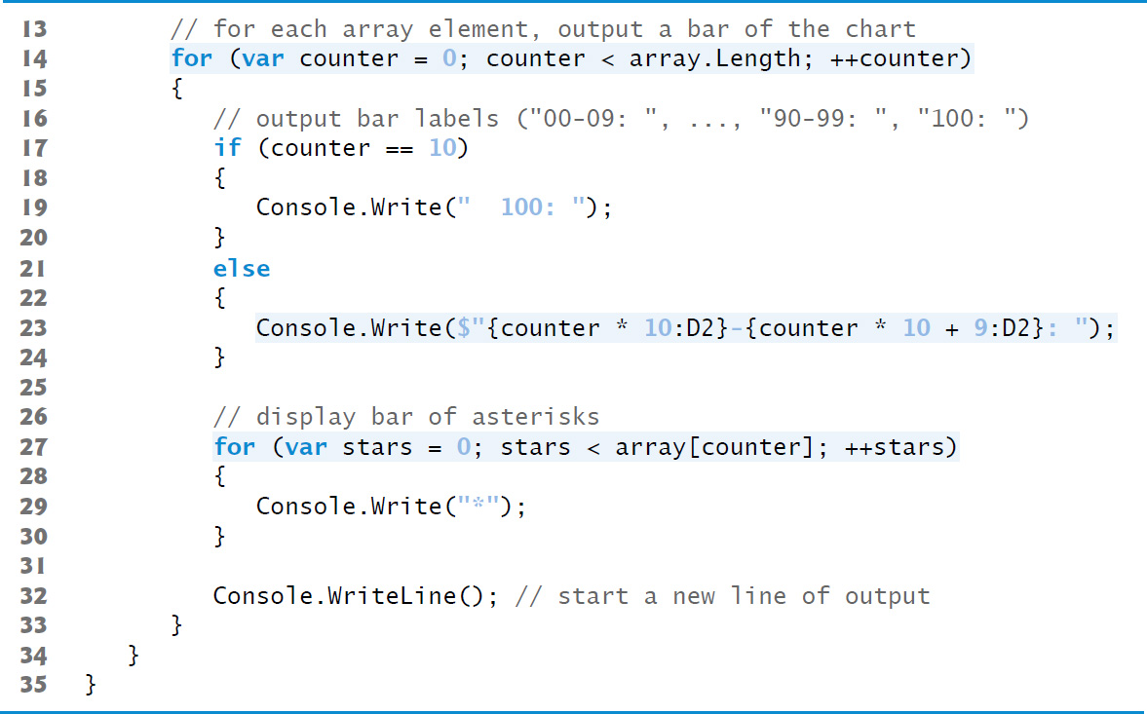
Figure 8.7 Bar Chart Displaying App (2 of 3)

Slide 41
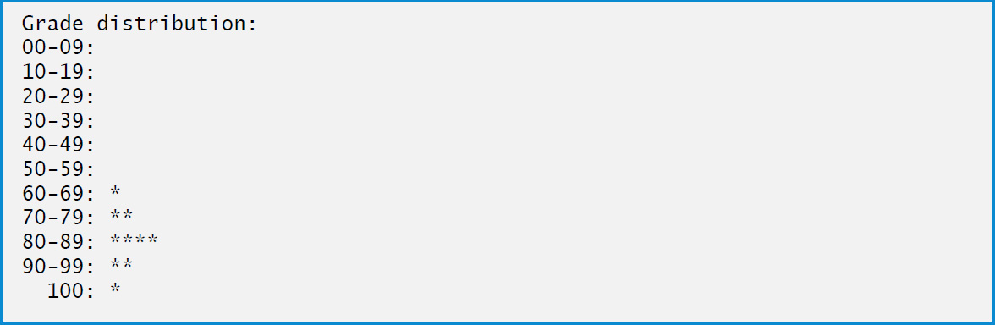
Figure 8.7 Bar Chart Displaying App (3 of 3)

Slide 42
8.4 Examples Using Arrays (9 of 9)
8.4.7 Using the Elements of an Array as Counters
An array version of our die-rolling app from Figure 7.7 is shown in Figure 8.8.

Slide 43
Common Programming Error 8.6
Initializer lists can be used with both arrays and collections. If an implicitly typed local variable is initialized via an initializer list without new[ ], a compilation error occurs, because the compiler cannot infer whether the variable should be an array or a collection. We use a List collection in Chapter 9 and cover collections in detail in Chapter 21.

Slide 44
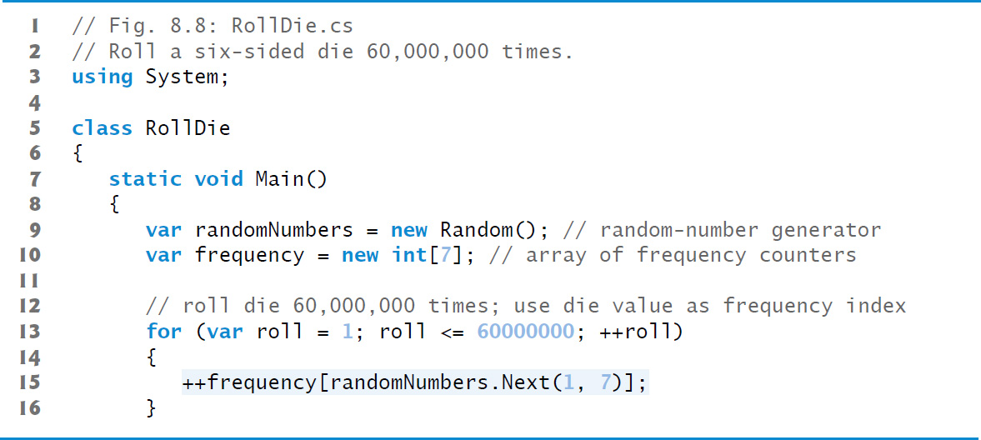
Figure 8.8 Roll a Six-Sided Die 60,000,000 Times (1 of 2)

Slide 45
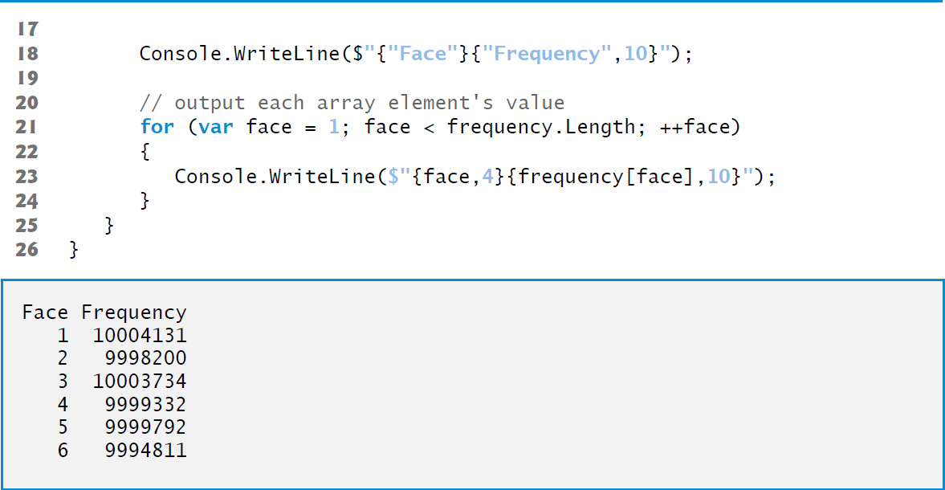
Figure 8.8 Roll a Six-Sided Die 60,000,000 Times (2 of 2)

Slide 46
8.5 Using Arrays to Analyze Survey Results; Intro to Exception Handling (1 of 8)
Figure 8.9 uses arrays to summarize data collected in a survey:
Twenty students were asked to rate on a scale of 1 to 5 the quality of the food in the student cafeteria, with 1 being “awful” and 5 being “excellent.” Place the 20 responses in an integer array and determine the frequency of each rating.

Slide 47
8.5 Using Arrays to Analyze Survey Results; Intro to Exception Handling (2 of 8)
When a
program executes, the runtime checks array
element indices for validity—all indices must be greater than or equal to 0 and less than the length of the array.
Any attempt to access an element outside that range of indices results in a runtime error that's known as an Index OutOfRangeException.
At the end of this section, we’ll discuss the invalid response value, demonstrate array bounds checking and introduce
exception-handling mechanism , which can be used to detect and handle an IndexOutOfRangeException.

Slide 48
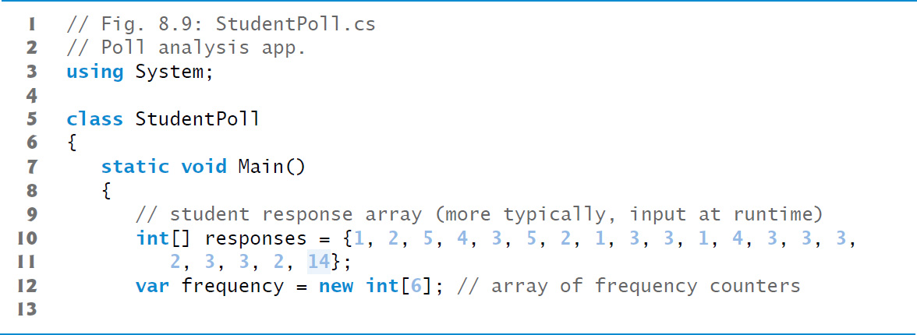
Figure 8.9 Poll Analysis App (1 of 4)

Slide 49
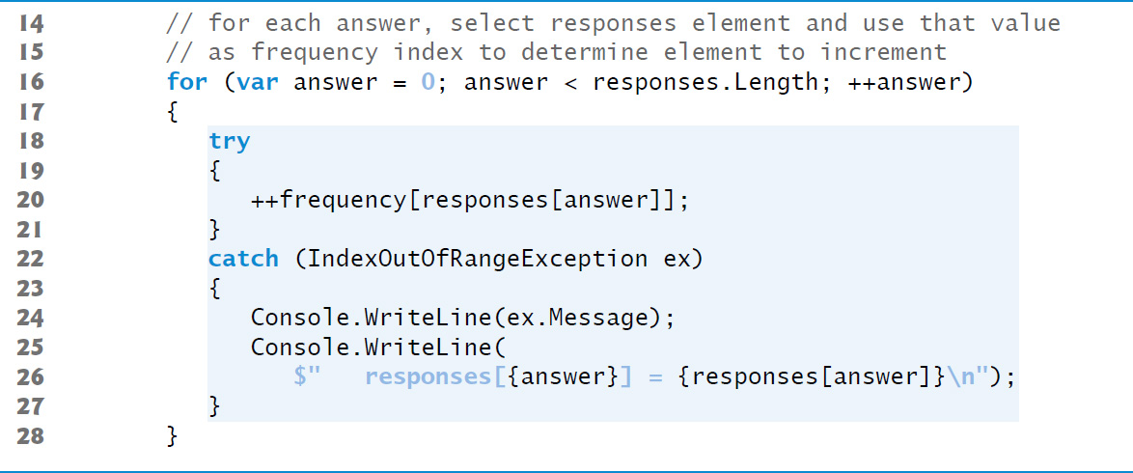
Figure 8.9 Poll Analysis App (2 of 4)

Slide 50
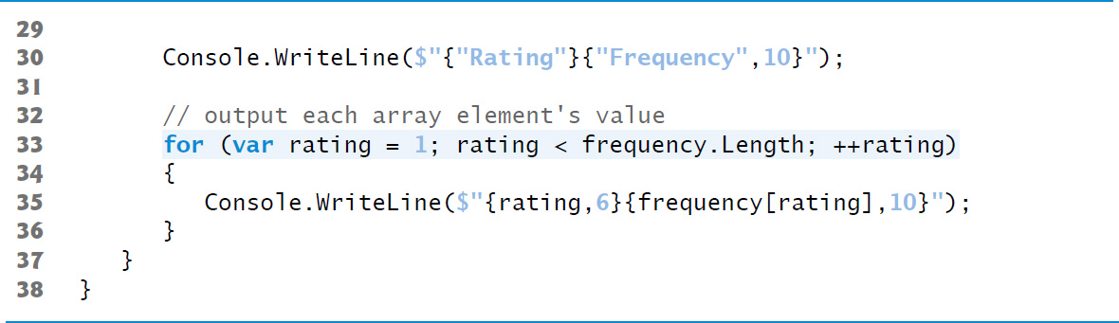
Figure 8.9 Poll Analysis App (3 of 4)

Slide 51
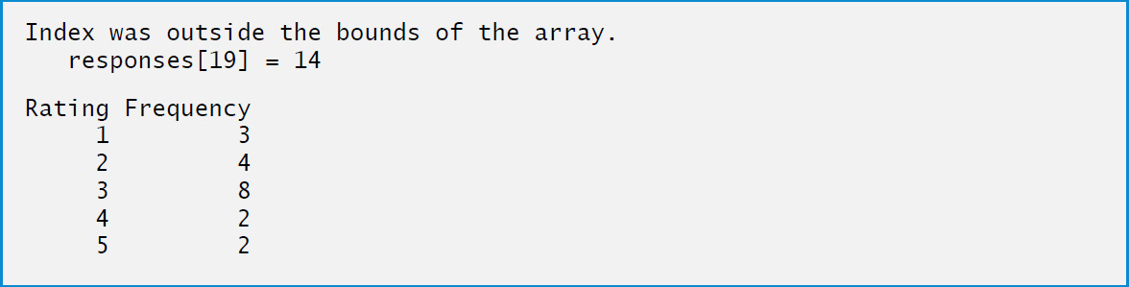
Figure 8.9 Poll Analysis App (4 of 4)

Slide 52
8.5 Using Arrays to Analyze Survey Results; Intro to Exception Handling (3 of 8)
Exception Handling: Processing the Incorrect Response
An exception indicates a problem that occurs while a program executes.
Exception handling enables you to create fault-tolerant programs that can resolve (or handle) exceptions.

Slide 53
8.5 Using Arrays to Analyze Survey Results; Intro to Exception Handling (4 of 8)
In many cases, this allows a program to continue executing as if no problems were encountered.
More severe problems might prevent a program from continuing normal execution, instead requiring the program to notify the user of the problem, then terminate.
When the runtime or a method detects a problem, such as an invalid array index or an invalid method argument, it throws an exception—that is, an exception occurs.

Slide 54
8.5 Using Arrays to Analyze Survey Results; Intro to Exception Handling (5 of 8)
The try Statement
To handle an exception, place any code that might throw an exception in a try statement.
The try block contains the code that might throw an exception, and the catch block contains the code that handles the exception if one occurs.

Slide 55
8.5 Using Arrays to Analyze Survey Results; Intro to Exception Handling (6 of 8)
Executing the catch Block
Because the runtime performs array bounds checking, it generates an exception—specifically line 20 throws an Index Out Of Range Exception to notify the program of this problem.
At this point the try block terminates and the catch block begins executing—if you declared any variables in the try block, they no longer exist, so they’re not accessible in the catch block.

Slide 56
8.5 Using Arrays to Analyze Survey Results; Intro to Exception Handling (7 of 8)
The catch block declares a type (Index Out Of Range Exception) and an exception parameter (ex).
The catch block can handle exceptions of the specified type.
Inside the catch block, you can use the parameter’s identifier to interact with a caught exception object.

Slide 57
Error-Prevention Tip 8.1
When writing code to access an array element, ensure that the array index remains greater than or equal to 0 and less than the length of the array. This will help prevent Index Out Of Range Exception in your program.

Slide 58
8.5 Using Arrays to Analyze Survey Results; Intro to Exception Handling (8 of 8)
Message Property of the Exception Parameter
When lines 22–27 catch the exception, the program displays a message indicating the problem that occurred.
Line 24 uses the exception object’s Message property to get the error message that's stored in the exception object and display it.

Slide 59
8.6 Case Study: Card Shuffling and Dealing Simulation
Class Card and Getter-Only Auto-Implemented Properties
Class Card (Figure 8.10) represents a playing card that has a face and a suit.
Prior to
auto-implemented properties required both
a get and a set accessor.
getter-only auto-implemented properties are read only.

Slide 60
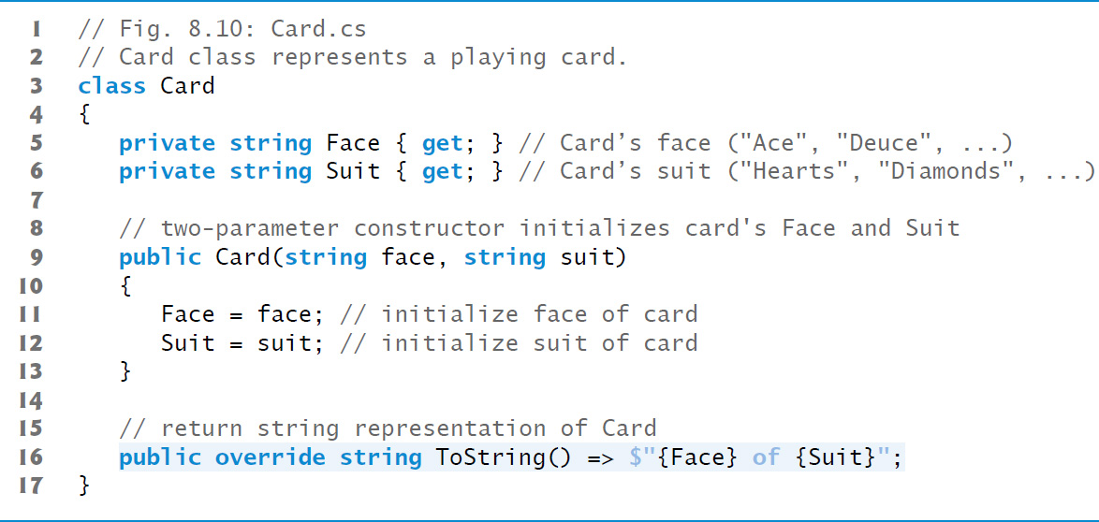
Figure 8.10 Card Class Represents a Playing Card

Slide 61
8.6 Case Study: Card Shuffling and Dealing Simulation (1 of 3)
Class Card and Getter-Only Auto-Implemented Properties
Getter-only auto-implemented properties can be initialized only either in their declarations or in all of the type’s constructors.
Initializing an auto-implemented property in its declaration
feature known as auto-property initializers.
is another

Slide 62
8.6 Case Study: Card Shuffling and Dealing Simulation (2 of 3)
Class DeckOfCards
Class DeckOfCards (Figure 8.11) represents a deck of 52 Card objects.

Slide 63
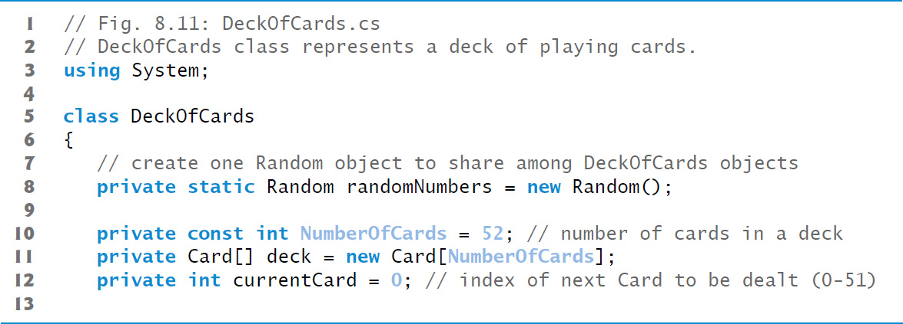
Figure 8.11 DeckOfCards Class Represents a Deck of Playing Cards (1 of 4)

Slide 64
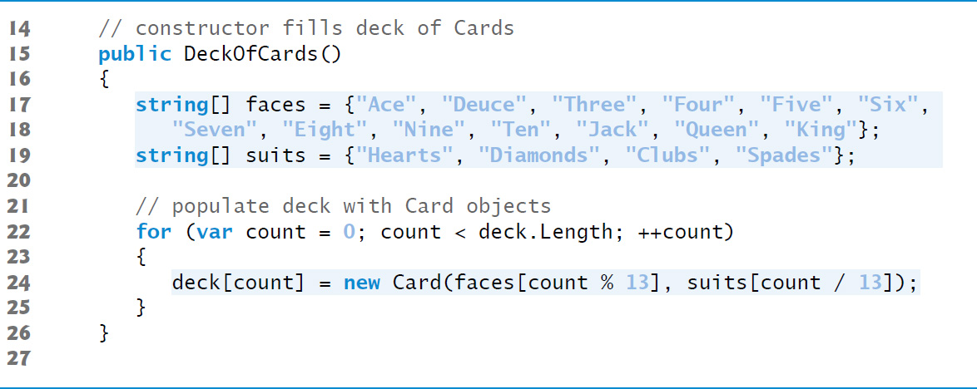
Figure 8.11 DeckOfCards Class Represents a Deck of Playing Cards (2 of 4)

Slide 65
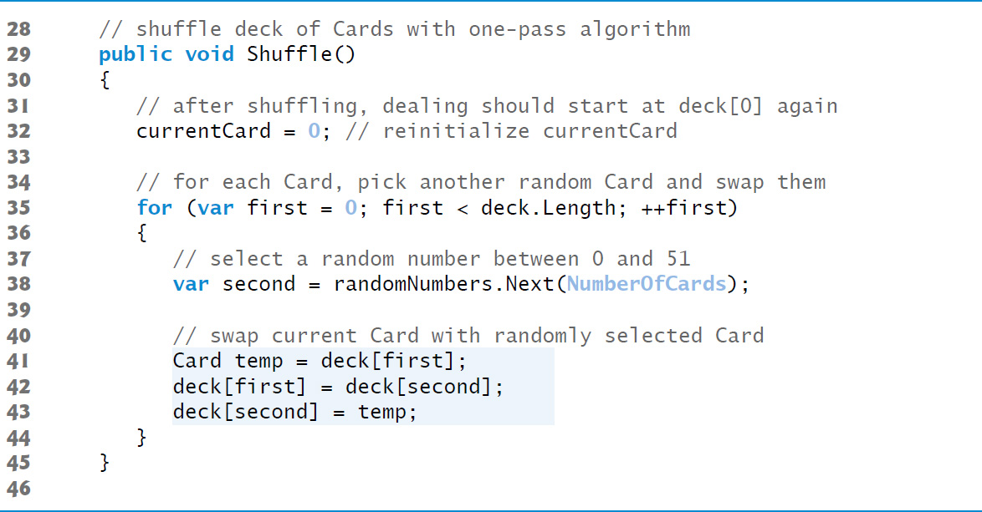
Figure 8.11 DeckOfCards Class Represents a Deck of Playing Cards (3 of 4)

Slide 66
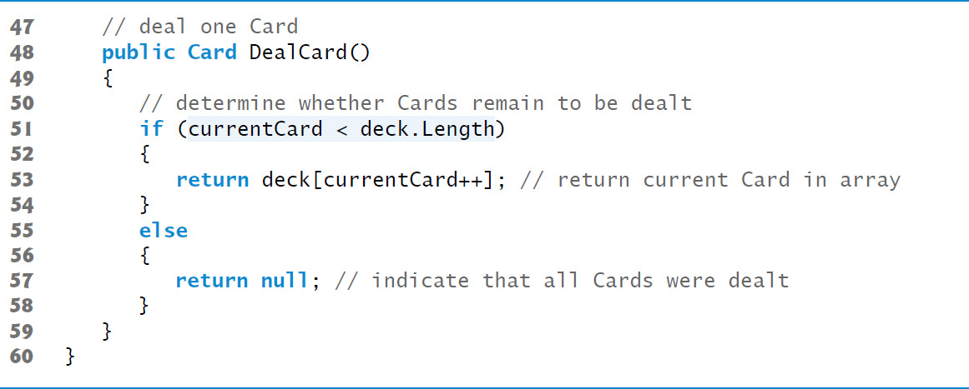
Figure 8.11 DeckOfCards Class Represents a Deck of Playing Cards (4 of 4)

Slide 67
8.6 Case Study: Card Shuffling and Dealing Simulation (3 of 3)
Shuffling and Dealing Cards
The app of Figure 8.12 demonstrates the card dealing and shuffling capabilities of class DeckOfCards.

Slide 68
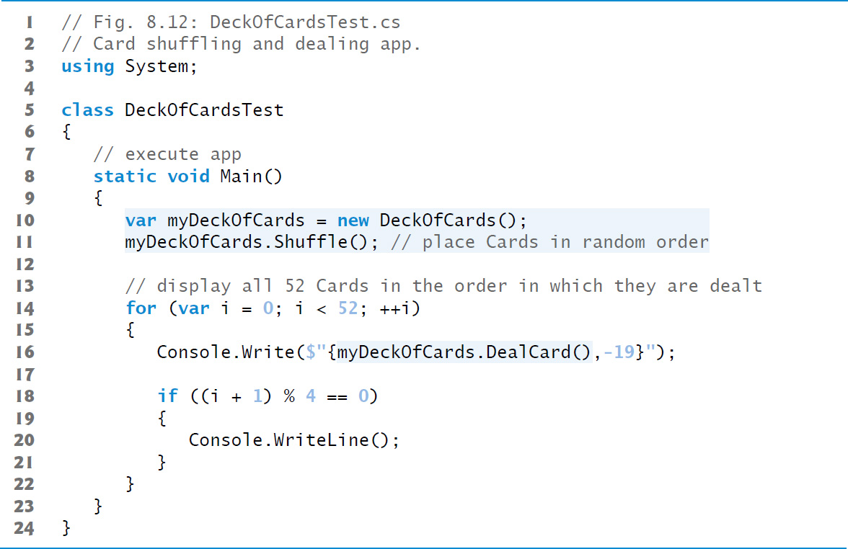
Figure 8.12 Card-Shuffling-and-Dealing App (1 of 2)

Slide 69
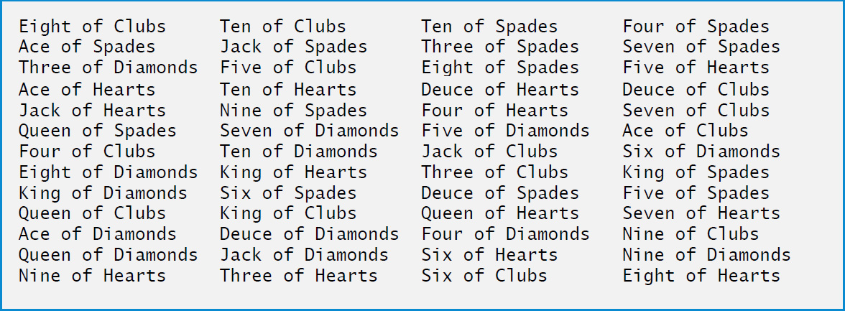
Figure 8.12 Card-Shuffling-and-Dealing App (2 of 2)

Slide 70
8.7 Passing Arrays and Array Elements to Methods (1 of 3)
To pass an array argument to a method, specify the name of the array without any brackets.
Specifying an Array Parameter
For a method to receive an array reference through a method call, the method’s parameter list must specify an array parameter.

Slide 71
8.7 Passing Arrays and Array Elements to Methods (2 of 3)
Pass-By-Value vs. Pass-By-Reference
When an argument to a method is an entire array or an individual array element of a reference type, the called method receives a copy of the reference.
When an argument to a method is an individual array element of a value type, the called method receives a copy of the element’s value.

Slide 72
8.7 Passing Arrays and Array Elements to Methods (3 of 3)
Passing an Entire Array vs. Passing a Single Array Element
To pass an individual array element to a method, use the indexed name of the array as an argument in the method call.
Figure 8.13 demonstrates the difference between passing an entire array and passing a value-type array element to a method.

Slide 73
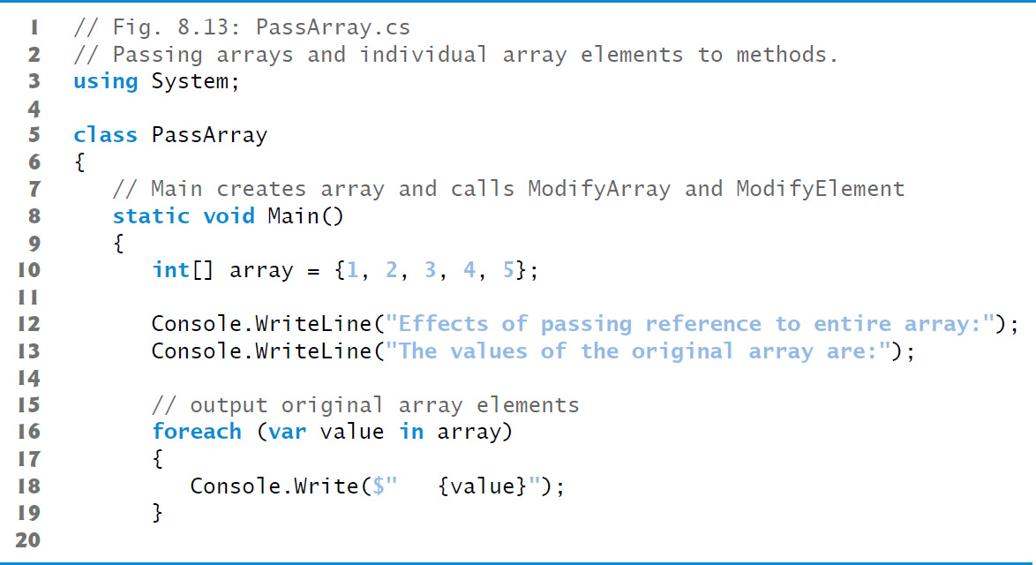
Figure 8.13 Passing Arrays and Individual Array Elements to Methods (1 of 4)

Slide 74
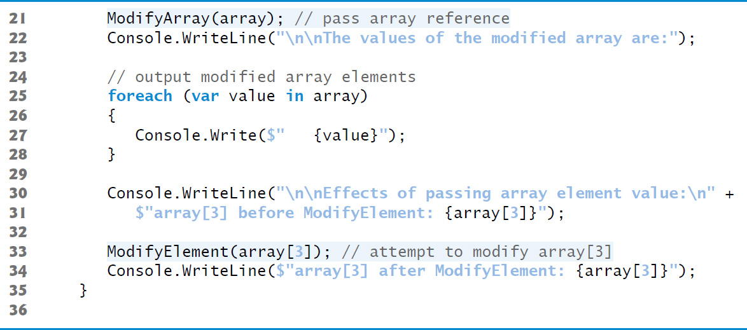
Figure 8.13 Passing Arrays and Individual Array Elements to Methods (2 of 4)

Slide 75
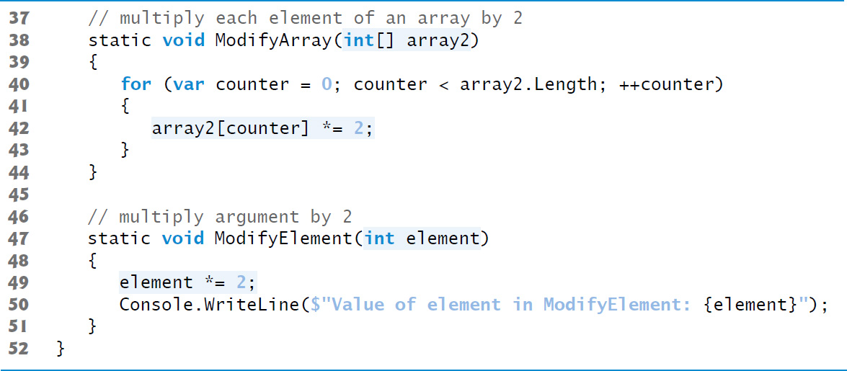
Figure 8.13 Passing Arrays and Individual Array Elements to Methods (3 of 4)

Slide 76
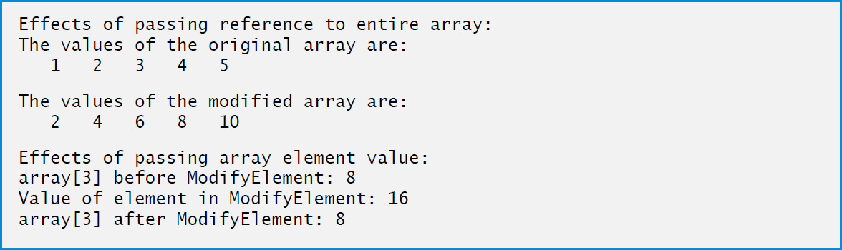
Figure 8.13 Passing Arrays and Individual Array Elements to Methods (4 of 4)

Slide 77
8.8 Case Study: GradeBook Using an Array to Store Grades
Storing Student Grades in an Array in Class GradeBook
Figure 8.14 shows the output of a program that tests class GradeBook.
Class GradeBook (Figure 8.15) uses an array of integers to store the grades of several students on a single exam.

Slide 78
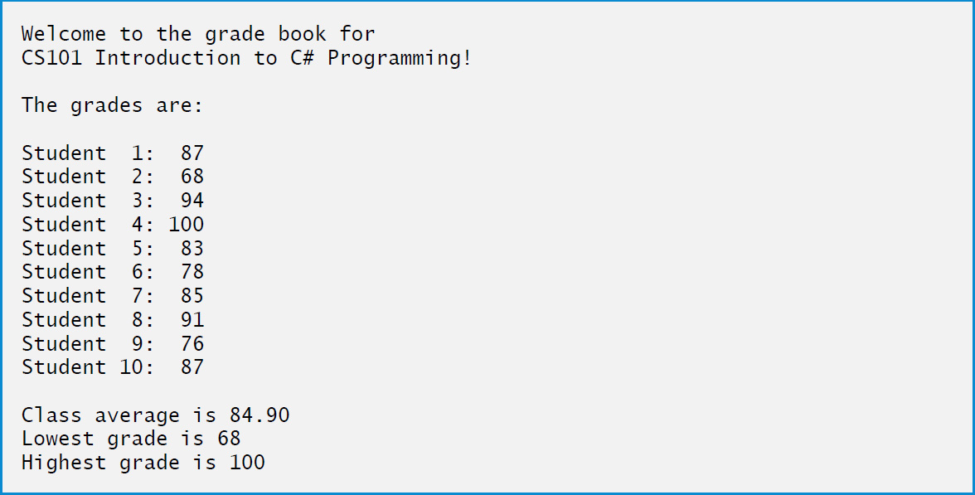
Figure 8.14 Output of the GradeBook Example That Stores One Exam's Grades in an Array (1 of 2)

Slide 79
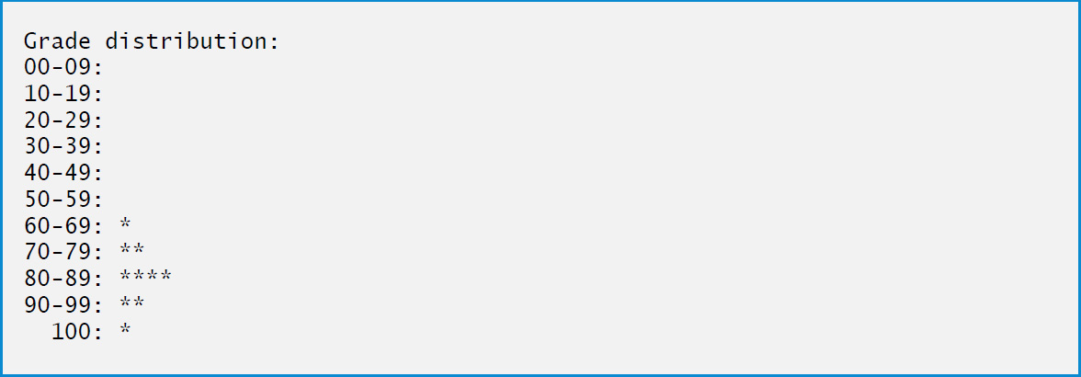
Figure 8.14 Output of the GradeBook Example That Stores One Exam's Grades in an Array (2 of 2)

Slide 80
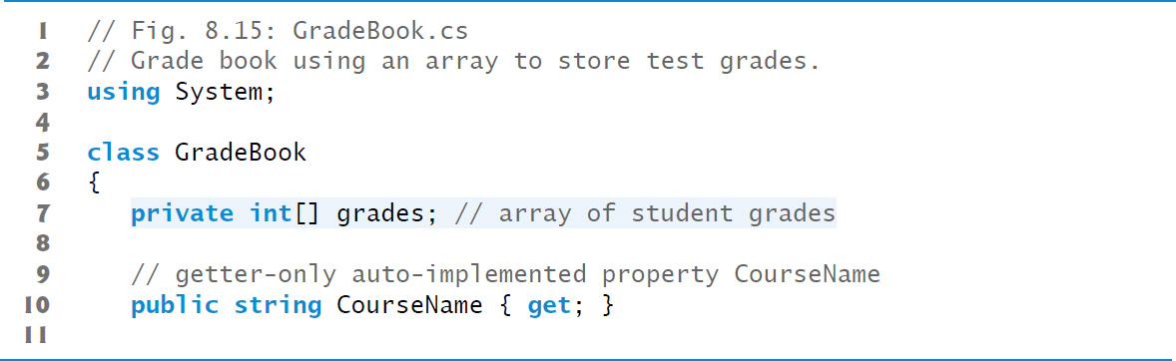
Figure 8.15 Grade Book Using an Array to Store Test Grades (1 of 9)

Slide 81
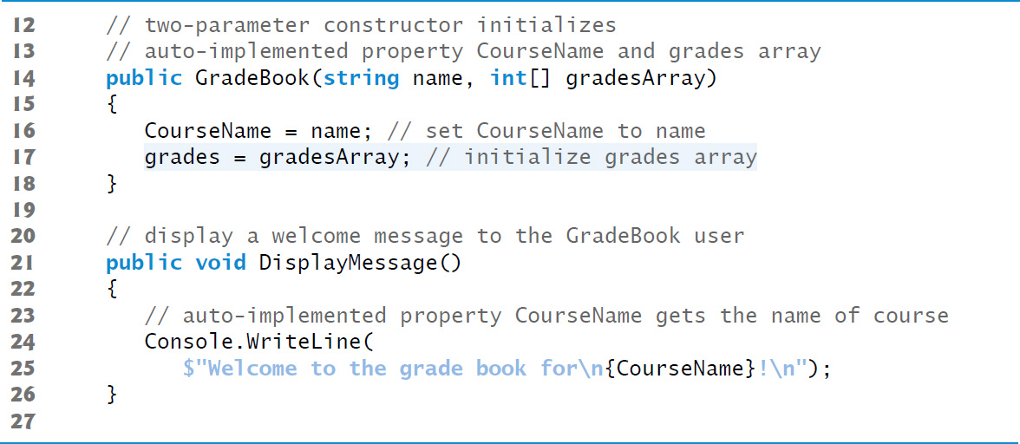
Figure 8.15 Grade Book Using an Array to Store Test Grades (2 of 9)

Slide 82
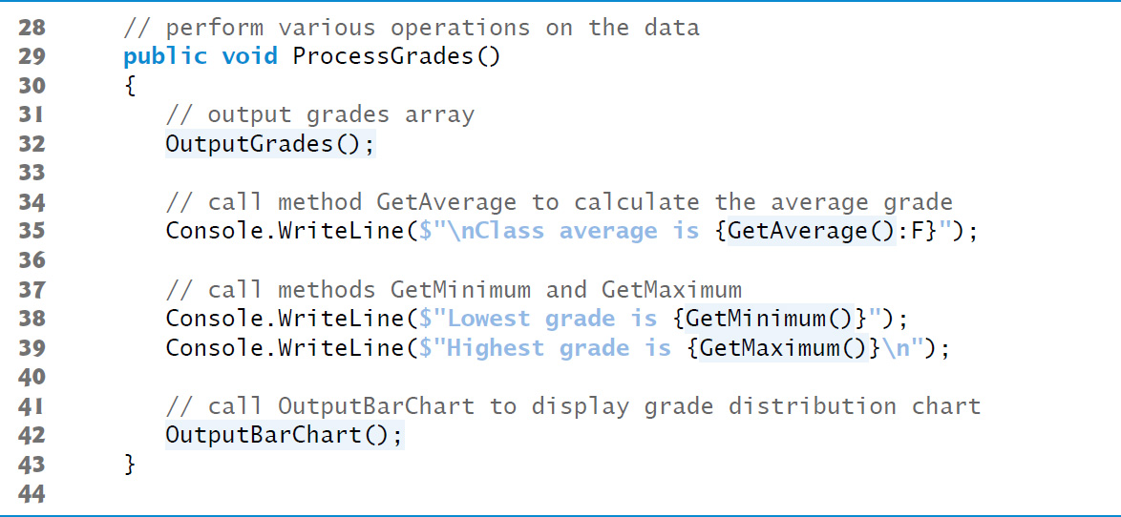
Figure 8.15 Grade Book Using an Array to Store Test Grades (3 of 9)

Slide 83
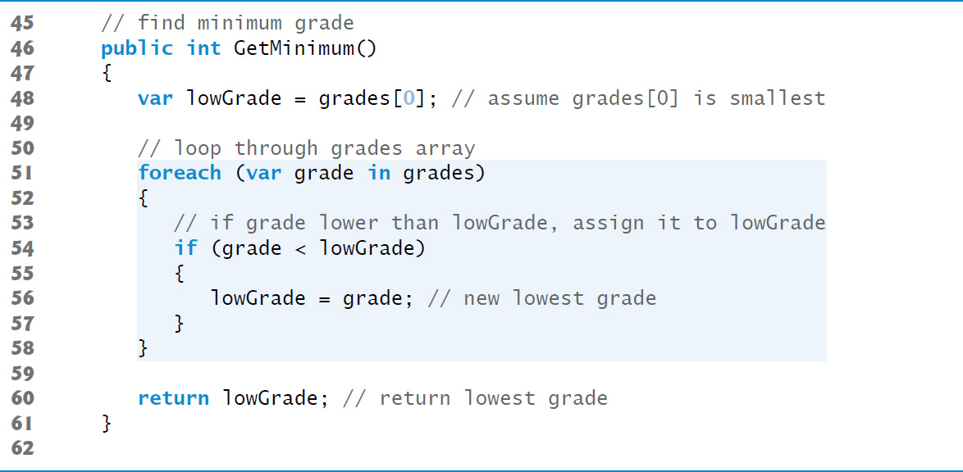
Figure 8.15 Grade Book Using an Array to Store Test Grades (4 of 9)

Slide 84
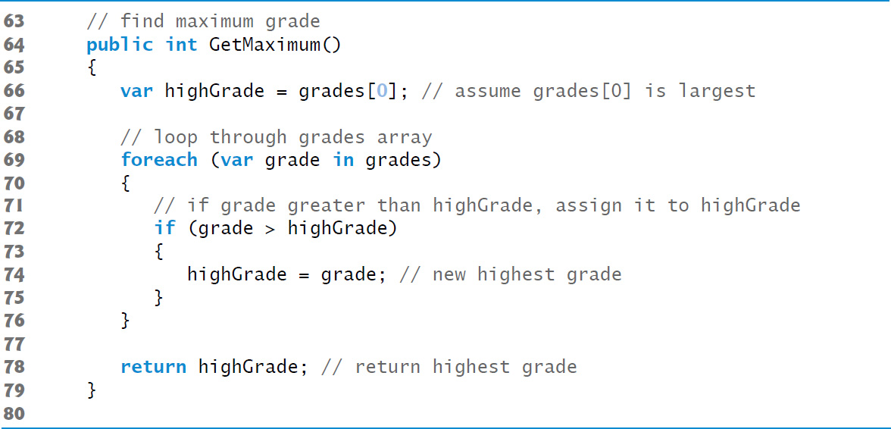
Figure 8.15 Grade Book Using an Array to Store Test Grades (5 of 9)

Slide 85
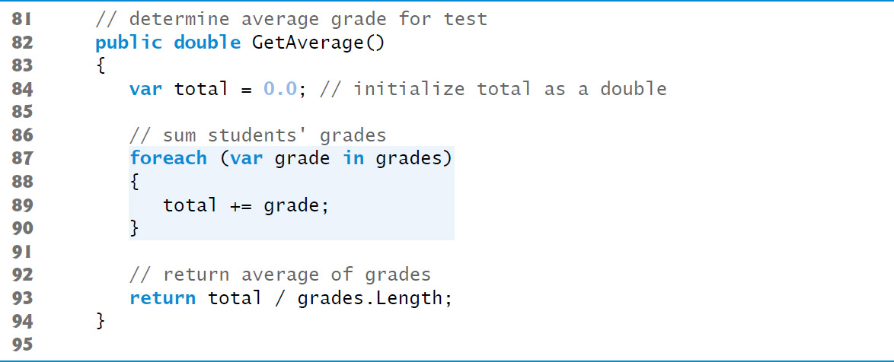
Figure 8.15 Grade Book Using an Array to Store Test Grades (6 of 9)

Slide 86
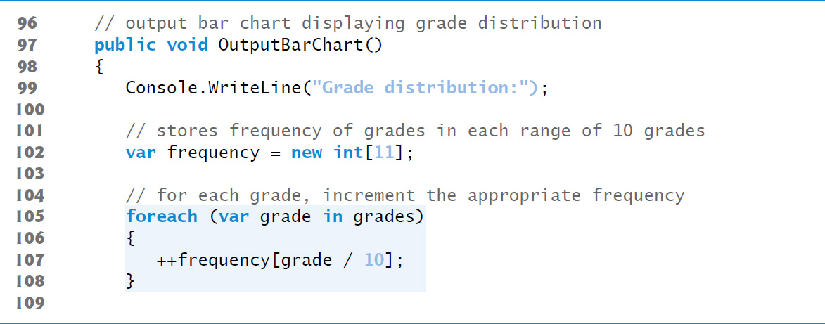
Figure 8.15 Grade Book Using an Array to Store Test Grades (7 of 9)

Slide 87
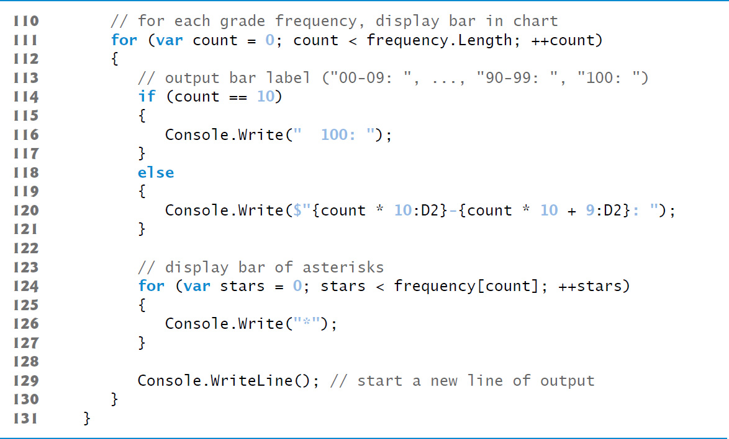
Figure 8.15 Grade Book Using an Array to Store Test Grades (8 of 9)

Slide 88
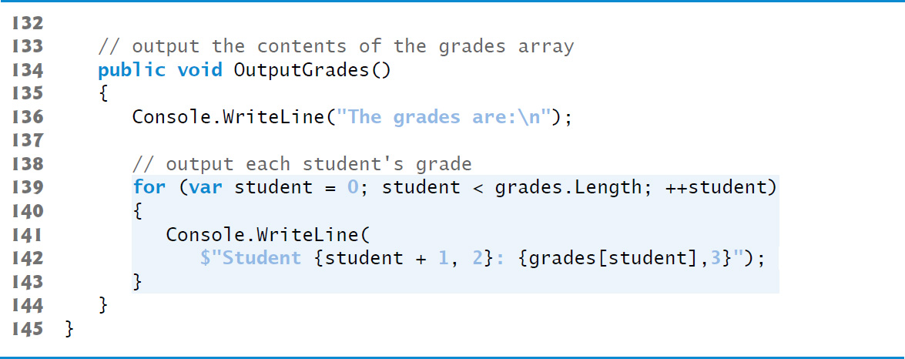
Figure 8.15 Grade Book Using an Array to Store Test Grades (9 of 9)

Slide 89
8.9 Case Study: Class GradeBook Using an Array to Store Grades
Class GradeBookTest That Demonstrates Class GradeBook
The app in Figure 8.16 demonstrates class GradeBook.

Slide 90
Software Engineering Observation 8.1
A test harness (or test app) creates an object of the class to test and provides it with data, which could be placed directly into an array with an array initializer, come from the user at the keyboard or come from a file (as you’ll see in Chapter 17). After initializing an object, the test harness uses the object’s members to manipulate the data. Gathering data in the test harness like this allows the class to manipulate data from several sources.

Slide 91
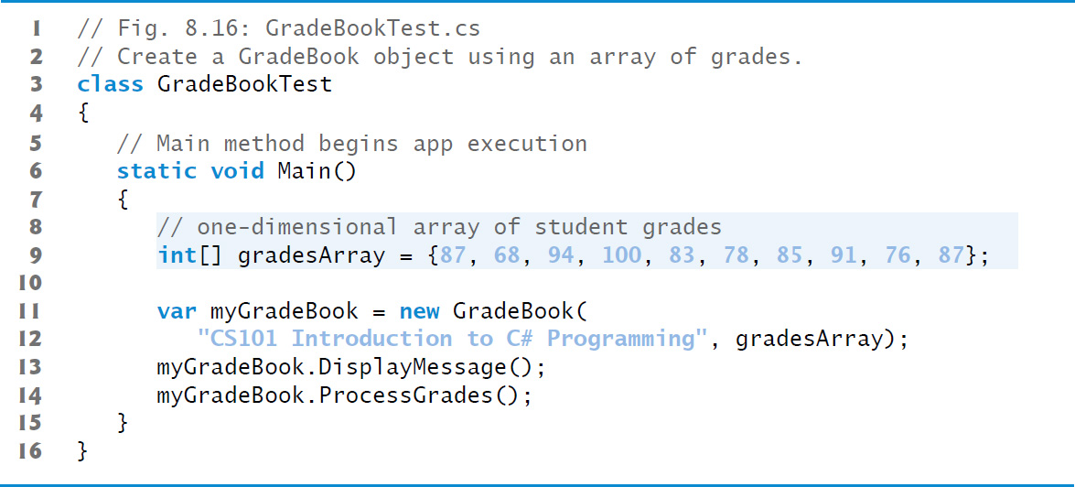
Figure 8.16 Create a GradeBook Object Using an Array of Grades

Slide 92
8.9 Multidimensional Arrays (1 of 6)
Two-dimensional arrays are often used to represent tables of values consisting of information arranged in rows and columns.
To identify a particular table element, we must specify two indices. By convention, the first identifies the element’s row and the second its column.

Slide 93
8.9 Multidimensional Arrays (2 of 6)
Rectangular Arrays
In rectangular arrays, each row has the same number of columns.
Figure 8.17 illustrates a three-by-four rectangular array named a.
An array with m rows and n columns is called an m-by-n array.

Slide 94
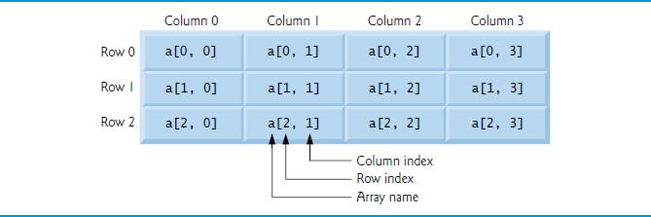
Figure 8.17 Rectangular Array with Three Rows and Four Columns

Slide 95
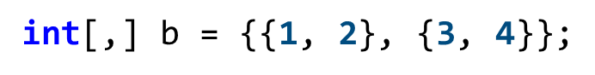
8.9 Multidimensional Arrays (3 of 6)
Array-Access Expression for a Two-Dimensional Rectangular Array
Every element in array a is identified by an array-access expression of the form a[row, column];
Array Initializer for a Two-Dimensional Rectangular Array
A two-by-two rectangular array b can be declared and initialized with nested array initializers as follows:
The initializer values are grouped by row in braces.
The compiler will generate an error if the number of initializers in each row is not the same, because every row of a rectangular array must have the same number of columns

Slide 96
8.9 Multidimensional Arrays (4 of 6)
Jagged Arrays
A jagged array is a one-dimensional array whose elements are one-dimensional arrays.
The lengths of the rows in the array need not be the same.

Slide 97
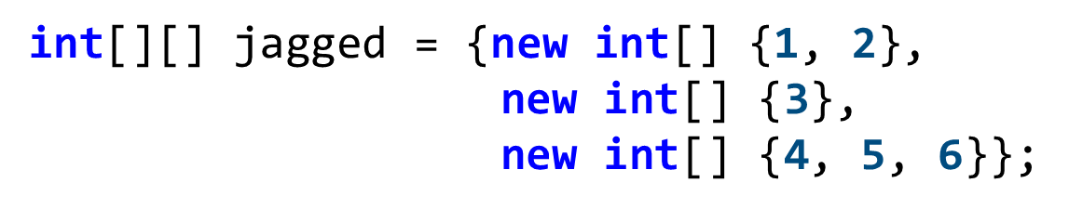
8.9 Multidimensional Arrays (5 of 6)
Array Initializer for a Two-Dimensional Jagged Array
Elements in a jagged array are accessed using an array-access expression of the form arrayName[row][column].
A jagged array with three rows of different lengths could be declared and initialized as follows:

Slide 98
8.9 Multidimensional Arrays (6 of 6)
Figure 8.18 illustrates the array reference jagged after it has been declared and initialized.

Slide 99
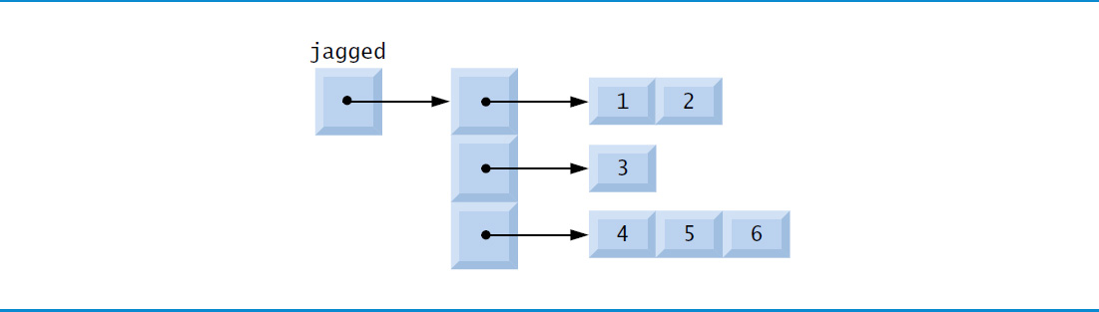
Figure 8.18 Jagged Array with Three Rows of Different Lengths

Slide 100


8.10 Multidimensional Arrays (1 of 2)
Creating Two-Dimensional Arrays with Array-Creation Expressions
A rectangular array can be created with an array-creation expression:
A jagged array cannot be completely created with a single array-creation expression. Each one-dimensional array must be initialized separately.
A jagged array can be created as follows:

Slide 101
8.10 Multidimensional Arrays (2 of 2)
Two-Dimensional Array Example: Displaying Element Values
Figure 8.19 demonstrates initializing rectangular and jagged arrays with array initializers and using nested for loops to traverse the arrays.

Slide 102

Figure 8.19 Initializing Jagged and Rectangular Arrays (1 of 4)

Slide 103

Figure 8.19 Initializing Jagged and Rectangular Arrays (2 of 4)

Slide 104

Figure 8.19 Initializing Jagged and Rectangular Arrays (3 of 4)

Slide 105

Figure 8.19 Initializing Jagged and Rectangular Arrays (4 of 4)

Slide 106
8.10 Case Study: GradeBook Using a Rectangular Array (1 of 2)
Storing Student Grades in a Rectangular Array in Class GradeBook
Figure 8.20 shows the output of a program that manipulates a GradeBook (Figure 8.21) that uses a rectangular array grades to store the grades of a number of students on multiple exams.

Slide 107

Figure 8.20 Output of GradeBook That Uses Two-Dimensional Arrays (1 of 2)

Slide 108

Figure 8.20 Output of GradeBook That Uses Two-Dimensional Arrays (2 of 2)

Slide 109

Figure 8.21 Grade Book Using a Rectangular Array to Store Grades (1 of 9)

Slide 110

Figure 8.21 Grade Book Using a Rectangular Array to Store Grades (2 of 9)

Slide 111

Figure 8.21 Grade Book Using a Rectangular Array to Store Grades (3 of 9)

Slide 112

Figure 8.21 Grade Book Using a Rectangular Array to Store Grades (4 of 9)

Slide 113

Figure 8.21 Grade Book Using a Rectangular Array to Store Grades (5 of 9)

Slide 114

Figure 8.21 Grade Book Using a Rectangular Array to Store Grades (6 of 9)

Slide 115

Figure 8.21 Grade Book Using a Rectangular Array to Store Grades (7 of 9)

Slide 116

Figure 8.21 Grade Book Using a Rectangular Array to Store Grades (8 of 9)

Slide 117

Figure 8.21 Grade Book Using a Rectangular Array to Store Grades (9 of 9)

Slide 118
Software Engineering Observation 8.2
“Keep it simple” is good advice for most of the code you’ll write.

Slide 119
8.10 Case Study: GradeBook Using a Rectangular Array (2 of 2)
Class GradeBookTest That Demonstrates Class GradeBook
The app in Figure 8.22 demonstrates class GradeBook.

Slide 120

Figure 8.22 Create a GradeBook Object Using a Rectangular Array of Grades (1 of 2)

Slide 121

Figure 8.22 Create a GradeBook Object Using a Rectangular Array of Grades (2 of 2)

Slide 122
8.11 Variable-Length Argument Lists
Variable-length argument lists allow you to create methods that receive an arbitrary number of arguments.
The necessary params modifier can occur only in the parameter list’s last parameter.
Figure 8.23 demonstrates method Average, which receives a variable-length sequence of doubles.

Slide 123
Common Programming Error 8.7
The params modifier may be used only with the last parameter of the parameter list.

Slide 124

Figure 8.23 Using Variable-Length Argument Lists (1 of 3)

Slide 125

Figure 8.23 Using Variable-Length Argument Lists (2 of 3)

Slide 126

Figure 8.23 Using Variable-Length Argument Lists (3 of 3)

Slide 127
8.12 Using Command-Line Arguments
You can pass command-line arguments to an app by including a parameter of type string[] in the parameter list of Main.
By convention, this parameter is named args.
The execution environment passes the command-line arguments as an array to the app’s Main method.
The number of arguments passed from the command line is obtained by accessing the array’s Length property.
Command-line arguments are separated by whitespace, not commas.
Figure 8.24 uses three command-line arguments to initialize an array.

Slide 128

Figure 8.24 Using Command-Line Arguments to Initialize an Array (1 of 4)

Slide 129

Figure 8.24 Using Command-Line Arguments to Initialize an Array (2 of 4)

Slide 130

Figure 8.24 Using Command-Line Arguments to Initialize an Array (3 of 4)

Slide 131

Figure 8.24 Using Command-Line Arguments to Initialize an Array (4 of 4)

Slide 132
8.13 Passing Arrays by Value and by Reference (1 of 2)
Changes to the local copy of a value-type argument in a called method do not affect the original variable in the caller.
If the argument is of a reference type, the method makes a copy of the reference, not a copy of the actual object that's referenced.

Slide 133
8.13 Passing Arrays by Value and by Reference (2 of 2)
You can use keyword ref to pass a reference-type variable by reference, which allows the called method to modify the original variable in the caller and make that variable refer to a different object.
This is a subtle capability, which, if misused, can lead to problems.
The app in Figure 8.25 demonstrates the subtle difference between passing a reference by value and passing a reference by reference with keyword ref.

Slide 134
Performance Tip 8.1
Passing references to arrays and other objects makes sense for performance reasons. If arrays were passed by value, a copy of each element would be passed. For large, frequently passed arrays, this would waste time and consume considerable storage for the copies of the arrays.

Slide 135

Figure 8.25 Testing the Effects of Passing an Array Reference by Value and by Reference (1 of 9)

Slide 136

Figure 8.25 Testing the Effects of Passing an Array Reference by Value and by Reference (2 of 9)

Slide 137

Figure 8.25 Testing the Effects of Passing an Array Reference by Value and by Reference (3 of 9)

Slide 138

Figure 8.25 Testing the Effects of Passing an Array Reference by Value and by Reference (4 of 9)

Slide 139

Figure 8.25 Testing the Effects of Passing an Array Reference by Value and by Reference (5 of 9)

Slide 140

Figure 8.25 Testing the Effects of Passing an Array Reference by Value and by Reference (6 of 9)

Slide 141

Figure 8.25 Testing the Effects of Passing an Array Reference by Value and by Reference (7 of 9)

Slide 142

Figure 8.25 Testing the Effects of Passing an Array Reference by Value and by Reference (8 of 9)

Slide 143

Figure 8.25 Testing the Effects of Passing an Array Reference by Value and by Reference (9 of 9)

Slide 144
Software Engineering Observation 8.3
When a method receives a reference-type parameter by value, a copy of the object’s reference is passed. This prevents a method from overwriting references passed to that method. In the vast majority of cases, protecting the caller’s reference from modification is the desired behavior. If you encounter a situation where you truly want the called procedure to modify the caller’s reference, pass the reference-type parameter using keyword ref—but, again, such situations are rare.

Slide 145
Software Engineering Observation 8.4
In
references to objects (including arrays) are passed
to called methods. A called method—receiving a reference to an object in a caller—can interact with, and possibly change, the caller’s object.

Slide 146

Copyright

